Slide 1
Software Engineering
Chapter 10
Software Verification –
Testing Strategies
Learning Outcomes
Be able to differentiate between different approaches to verification
Understand the testing process
Text: Bruegge & Dutoit Chapter 11
Notes:
Things you should look up:
Pressman - chapter’s 1 & 2

Slide 2
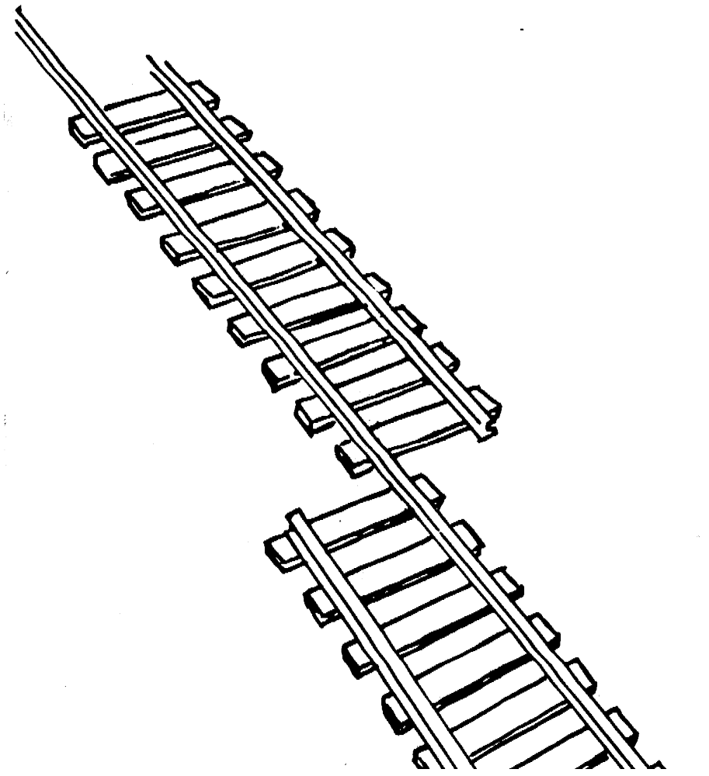
What is this?
A failure?
An error?
A fault?
Need to specify
the desired behaviour first!

Slide 3
What is this?
Error!

Slide 4
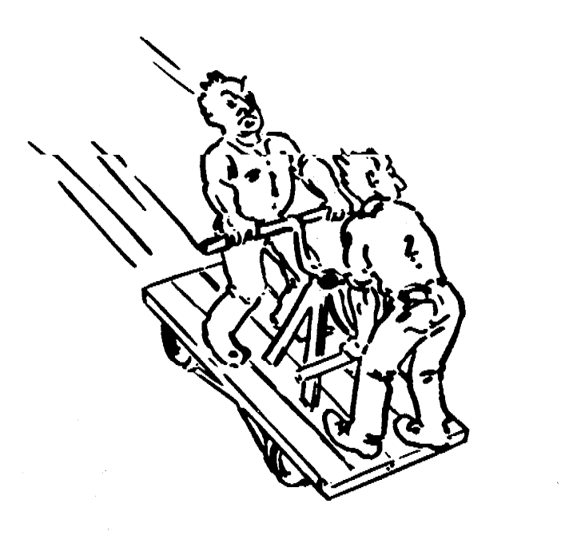
Testing?

Slide 5
Definitions?
Failure
Error
Fault
Testing

Slide 6
Definitions?
Failure – any deviation in the observed behaviour from the specified behaviour
Error – the system is in a state where further processing will lead to failure
Fault – the cause of an error
Testing – the systematic attempt to find faults in a planned way in the implemented software

Slide 7
Dynamic and static verification
Dynamic verification Concerned with exercising and
observing product behaviour (testing)
  includes executing the code
Static verification Concerned with analysis of
the static system representation to discover problems
  does not include execution

Slide 8
Testing Activities
Which document?
Subsystem
Code
Unit
Tested
Subsystem
??
Document
T
est
??
Subsystem
Code
Unit
T
est
Tested
Subsystem
Integration
System
Test
Test
Integrated
Subsystems
Functioning
System
Tested
Subsystem
Subsystem
Code
Unit
developer
T
est

Slide 9
Testing Activities
Requirements Specification
Subsystem
Code
Unit
Tested
Subsystem
System
Design
Document
T
est
User
Manual
Subsystem
Code
Unit
T
est
Tested
Subsystem
Integration
System
Test
Test
Integrated
Subsystems
Functioning
System
Tested
Subsystem
Subsystem
Code
Unit
developer
T
est

Slide 10
Testing Activities continued
What data?
User
Environment
Validated
System
Accepted
System
Acceptance
Installation
Test (α)
Test (β)
Usable
System
User’s understanding
System in
User/client
Use

Slide 11
Testing Activities continued
Client’s
Understanding
of Requirements
User
Environment
Validated
System
Accepted
System
Acceptance
Installation
Test (α)
Test (β)
Usable
System
User’s understanding
System in
User/client
Use

Slide 12
Types of Testing
Unit Testing:
  Individual subsystem
  Carried out by developers
  Goal: ??
Integration Testing:
  Groups of subsystems (collection of classes) and eventually the entire system
  Carried out by developers
  Goal: ??

Slide 13
Types of Testing
Unit Testing:
  Individual subsystem
  Carried out by developers
  Goal: Confirm that each subsystem is correctly coded and carries out the intended functionality
Integration Testing:
  Groups of subsystems (collection of classes) and eventually the entire system
  Carried out by developers
  Goal: Test the interfaces between the subsystems

Slide 14
Types of Testing cont.
System Testing:
  The entire system
  Carried out by developers
  Goal: ??
Acceptance Testing:
  Evaluates the system delivered by developers
  Carried out by the client. May involve executing typical transactions on site on a trial basis
  Goal: ??

Slide 15
Types of Testing cont.
System Testing:
  The entire system
  Carried out by developers
  Goal: Determine if the system meets the requirements (functional and global)
Acceptance Testing:
  Evaluates the system delivered by developers
  Carried out by the client. May involve executing typical transactions on site on a trial basis
  Goal: Demonstrate that the system meets customer requirements and is ready to use

Slide 16
Regression Testing – Example JUnit
JUnit - Erich Gamma and Kent Beck - http://www.junit.org
  Also CPPUnit and others
Unit tests in Java that can be run at any time
  …but typically after some change has been made
Automated
You can test first – i.e. write the tests before the code!
  New code written only when there is a test that doesn’t work

Slide 17
Unit testing
Objective: to discover defects in programs
Successful test: a test which causes a program to behave in an anomalous way
Tests show the presence not the absence of defects
Only exhaustive testing can show a program is free from defects - however, exhaustive testing is impossible
Test data = Inputs which have been devised to test system
Test cases = Inputs to test the system and the predicted outputs from these inputs if the system operates according to its specification: at a high level these are based on the system’s use cases
test cases
test data
test results
test report
Design test cases
Prepare Test Data
Run program with test data
Compare results to test cases

Slide 18
Unit testing techniques
Informal:
  Incremental coding
Static Analysis:
  Hand execution: reading the source code
  Walkthrough (informal presentation to others)
  Code inspection (formal presentation to others)
  Automated Tools checking for
    syntactic and semantic errors
    departure from coding standards
Dynamic Analysis:
  Black-box testing (Test the input/output behavior)
  White-box testing (Test the internal logic of the subsystem or object)
  Data-structure based testing (Data types determine test cases)

Slide 19
Black-box testing
Approach to testing where the program is considered as a ‘black-box’
The program test cases are based on the system specification
Inputs from test data may reveal anomalous outputs i.e. defects
Test planning can begin early in the software process
Main problem - selection of inputs
  equivalence partitioning
Test cases
Test results
Requirements
Program

Slide 20
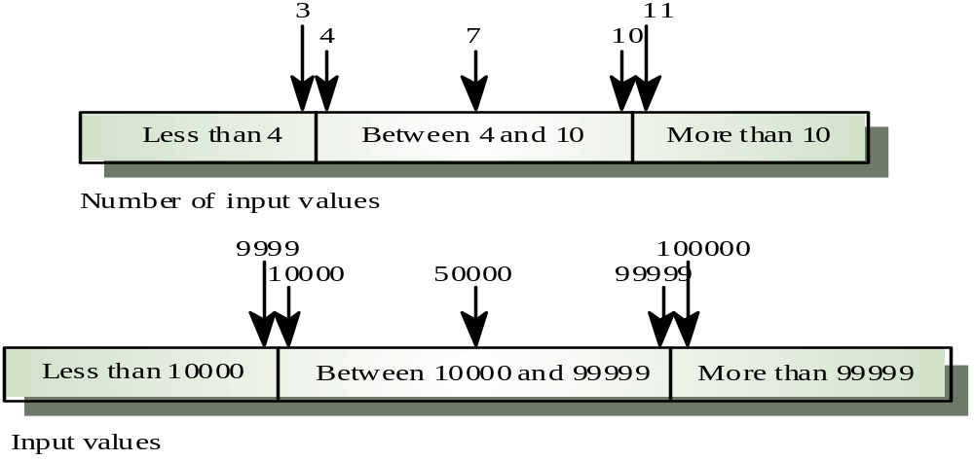
Equivalence partitioning
Partition system inputs and outputs into ‘equivalence sets’
  If an input should be between 4 and 10, choose
    1 number < 4, 1 number between 4-10 and 1 number >10
  If input is a 5-digit integer between 10,000 and 99,999,
  equivalence partitions are
    <10,000, 10,000-99,999 and >= 100,000
Choose test cases at the boundary of these sets

Slide 21
White box testing
Sometimes called structural testing or glass box testing
Derivation of test cases according to program structure.
  Knowledge of the program used to identify additional test cases
Objective is to exercise all program statements
(not all path combinations)
Four types of white-box testing
  Statement Testing – test single statements
  Loop Testing – test loop for
    Execute 0, 1 and n times
  Path Testing – execute every path
  Branch Testing – every outcome from every condition is tested
Test cases
Code Code Code Code Code Code Code Code Code Code Co
de Code Code
Code Code Code Code Code Code Code Code Code Code Code Code Code Code Code Code Code Code Code Code Code Code Code Code Code Code Code Code Code Code Code
Code Code Code Code Code Code Code
Code Code Code Code Code
Code Code Code Code Code Code Code Code Code Code Code Code Code Code Code Code Code Co
de Code Code Code Code Code Code Code Code Code Code Code Code Co
e Code Code Code Co
de Code Code Code Code Code Code Code Code Code
Code Code Code Code Code Code Code Code Code Code Code Code Code Code Code Code Code Code Code Code Code
Code Code Code Code Code Code Code Code Code Code Code Code Code Code Code Code Code Code Code Code Code Code Code Code Code Code Code Code Code Code Code Code Code Code Code Code Code Code Code Code Code Code Code Code Code Code Code Code Code Code Code Code Code Code Code Code Code Code Code Code Code
Test results

Slide 22
Comparison of White- & Black-box
White-box Testing:
Black-box Testing:

Slide 23
Comparison of White- & Black-box
White-box Testing:
  Potentially infinite number of paths have to be tested
  White-box testing often tests what is done, instead of what should be done
  Cannot detect missing use cases
Black-box Testing:
  Potential combinatorial explosion of test cases
  (valid & invalid data)
  Often not clear whether the selected test cases uncover a particular error

Slide 24
Static verification
Verifying the conformance of a software system and its specification without executing the code...
Involves analysis of source text by humans or software
...on ANY documents produced as part of the software process
Discovers errors early in the software process
2 main techniques
  walkthroughs - 4-6 people examine code & list perceived problems, then meet to discuss
  program inspections (Fagan) - formal approach using checklists
Is this as effective as dynamic testing?

Slide 25
Static verification
Verifying the conformance of a software system and its specification without executing the code
Involves analysis of source text by humans or software
on ANY documents produced as part of the software process
Discovers errors early in the software process
2 main techniques
  walkthroughs - 4-6 people examine code & list perceived problems, then meet to discuss
  program inspections (Fagan) - formal approach using checklists
Is this as effective as dynamic testing?
  Usually more cost-effective than testing for defect detection at the unit and module level
  > 60% of program errors can be detected in software inspections

Slide 26
Fagan Software Inspections*
Typically involve:
  Author – the programmer
  Inspector – finds errors, omissions, inconsistencies
  Reader – paraphrases the code/ document at the meeting
  Scribe – records results
  Chairman – manages the process
  Chief moderator – improving the inspection process, updating the checklist
Checklist may look for
  Data faults e.g. variables not initialised, variables declared but not used, variables assigned twice but not used in between, array bound violations, undeclared variables
  Control faults e.g. unreachable code, unconditional branches
  I-O faults e.g. variables output twice but nothing changes in between
  Interface faults e.g. parameter type mismatch, parameter number mismatch, uncalled methods
  Storage management faults e.g. unassigned pointers, pointer arithmetic.
*named after Michael Fagan, IBM, and his series of papers from the 1970s onwards

Slide 27
Stress Testing
Some systems need to handle specified loads
  E.g. transaction processing systems
  Web-based systems
Stress Testing
  Tests the failure behaviour of the system
  Shows up defects that only occur under high volume

Slide 28
Integration Testing Strategy
The order in which the subsystems are selected for testing and integration determines the testing strategy
  Big bang integration (Non-incremental)
  Bottom-up integration
  Top-down integration
  Sandwich testing

Slide 29
Example: Three Layer Call Hierarchy
A
Layer I
B
C
D
Layer II
E
F
G
Layer III

Slide 30
Integration Testing: Big-Bang Approach
Unit Test
A
Typical but not the best way!
‘The most obvious combined strategy is pure "big bang" integration, in which the entire system is assembled and tested in one step without even prior module testing.’
(National Institute of Standards and Technology)
Unit Test
B
Unit Test
C
System Test
Unit Test
D
Unit Test
E
A
Layer I
Unit Test
F
B
C
D
Layer II
Unit Test
G
E
F
G
Layer III

Slide 31
Bottom-up Testing Strategy
Lowest layer subsystems tested individually
Next subsystems tested that call those subsystems
Repeat until all subsystems are included in the testing
Need Special program = “Test Driver”
  Test Driver calls a subsystem and passes a test case to it
A
Layer I
B
C
D
Layer II
E
F
G
Layer III
Test E
Disadvantages
Advantages
Test B, E, F
Test F
Test
A, B, C, D,
E, F, G
Test C
Test D,G
Test G

Slide 32
Bottom-up Testing Strategy
Lowest layer subsystems tested individually
Next subsystems tested that call those subsystems
Repeat until all subsystems are included in the testing
Need Special program = “Test Driver”
  Test Driver calls a subsystem and passes a test case to it
A
Layer I
B
C
D
Layer II
E
F
G
Layer III
Test E
Disadvantages
  Tests the most important subsystem (UI) last
Advantages
  Useful for integrating OO systems
Test B, E, F
Test F
Test
A, B, C, D,
E, F, G
Test C
Test D,G
Test G

Slide 33
Top-down Testing Strategy
A
Layer I
Test top layer i.e. controlling subsystem first
Test each of the called subsystems
Repeat until all subsystems are incorporated into the test
Special program is needed to do the testing, Test stub :
  simulates the activity of a missing subsystem
B
C
D
Layer II
E
F
G
Layer III
Disadvantages
Advantages
Test
A, B, C, D,
E, F, G
Test A
Test A, B, C, D
Layer I
Layer I + II
All Layers

Slide 34
Top-down Testing Strategy
A
Layer I
Test top layer i.e. controlling subsystem first
Test each of the called subsystems
Repeat until all subsystems are incorporated into the test
Special program is needed to do the testing, Test stub :
  simulates the activity of a missing subsystem
B
C
D
Layer II
E
F
G
Layer III
Disadvantages
  Writing stubs difficult
  very large number of stubs may be required
Advantages
  Test cases can be defined in terms of the functionality of the system (functional requirements)
Test
A, B, C, D,
E, F, G
Test A
Test A, B, C, D
Layer I
Layer I + II
All Layers

Slide 35
Sandwich Testing Strategy
Combines top-down strategy with bottom-up strategy
How do you select the target layer if there are more than 3 layers?
  Heuristic: ?
A
Layer I
B
C
D
Layer II
Test E
Disadvantages
  ?
Advantages
  ?
E
F
G
Layer III
Test B, E, F
Bottom
Layer
Tests
Test F
Test
A, B, C, D,
E, F, G
Test D,G
Test G
Test A,B,C, D
Top
Layer
Tests
Test A

Slide 36
Sandwich Testing Strategy
Combines top-down strategy with bottom-up strategy
How do you select the target layer if there are more than 3 layers?
  Heuristic: try to minimize the number of stubs (called programs) and drivers (calling programs)
A
Layer I
B
C
D
Layer II
Test E
Disadvantages
  Does not test ALL the individual subsystems thoroughly before integration
Advantages
  Parallel Top and Bottom Layer Tests
E
F
G
Layer III
Test B, E, F
Bottom
Layer
Tests
Test F
Test
A, B, C, D,
E, F, G
Test D,G
Test G
Test A,B,C, D
Top
Layer
Tests
Test A

Slide 37
System Testing
Functional Testing (same as black box)
Structure Testing (same as white box)
Performance Testing
Acceptance Testing
Installation Testing
Impact of requirements on system testing:

Slide 38
System Testing
Functional Testing (same as black box)
Structure Testing (same as white box)
Performance Testing
Acceptance Testing
Installation Testing
Impact of requirements on system testing:
  The more explicit the requirements, the easier they are to test
  Quality of use cases determines the ease of functional testing
  Quality of subsystem decomposition
  determines the ease of structure testing
  Quality of nonfunctional requirements and constraints
  determines the ease of performance tests:

Slide 39
Performance Testing
Stress Testing
Volume testing
Configuration testing
Compatibility test
Security testing
Timing testing
Environmental test
Quality testing
Recovery testing
  .
Human factors testing

Slide 40
Performance Testing
Stress Testing
  Stress limits of system (maximum # of users, peak demands, extended operation)
Volume testing
  Test what happens if large amounts of data are handled
Configuration testing
  Test the various software and hardware configurations
Compatibility test
  Test backward compatibility with existing systems
Security testing
  Try to violate security requirements
Timing testing
  Evaluate response times and time to perform a function
Environmental test
  Test tolerances for heat, humidity, motion, portability
Quality testing
  Test reliability, maintainability & availability of the system
Recovery testing
  Tests system’s response to presence of errors or loss of data.
Human factors testing
  Tests user interface with user

Slide 41
Acceptance Testing
Goal: Demonstrate system is ready for operational use
  Choice of tests is made by client/sponsor
  Many tests can be taken from integration testing
  Acceptance test is performed by the client, not by the developer.
Alpha test:
Beta test:

Slide 42
Acceptance Testing
Goal: Demonstrate system is ready for operational use
  Choice of tests is made by client/sponsor
  Many tests can be taken from integration testing
  Acceptance test is performed by the client, not by the developer.
Alpha test:
  Sponsor uses the software at the developer’s site.
  Software used in a controlled setting, with the developer always ready to fix bugs.
Beta test:
  Conducted at sponsor’s site (developer is not present)
  Software gets a realistic workout in target environment
  Potential customer might get discouraged

Slide 43
Sample Acceptance Plan
Bookings Features
ID | Use case ref | Description of Test | Test Initialisation | Test Inputs | Test Procedure | Expected Results | Passed?
01 | UC01 | Testing the display of bookings | Enter some bookings for 1/04/2012 | Date: 1/04/2012 Table for 4 Table for 3 | Enter the date (01/04/2012) | Bookings 1 and 2 are displayed | No – only the first booking displayed
Etc…
Table Management Features...

Slide 44
Software Engineering
Chapter 10
Software Verification –
Testing Strategies
Learning Outcomes
Be able to differentiate between different approaches to verification
Understand the testing process
Text: Bruegge & Dutoit Chapter 11
Notes:
Things you should look up:
Pressman - chapter’s 1 & 2

